Slide 1
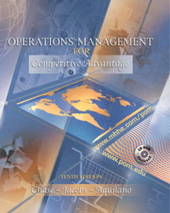

Slide 2
Supplement B
Financial Analysis

Slide 3
OBJECTIVES
Cost Definitions
Expected Value
Depreciation
Activity-Based Costing
Investment Categories
Cost of Capital
Interest Rate Effects
Methods of Ranking Investments
Notes:
2

Slide 4
Cost Definitions
Fixed costs are any expenses that remains constant regardless of the level of output
Variable costs are expenses that fluctuate directly with changes in the level of output
Sunk costs are past expenses or investments that have no salvage value and therefore should not be taken into account in considering investment alternatives
Notes:
3

Slide 5
Cost Definitions (Continued)
Opportunity cost is the benefit forgone, or advantage lost, that results from choosing one action over the best alternative course of action
Avoidable costs include any expense that is not incurred if an investment is made but must be incurred if the investment is not made
Notes:
3

Slide 6
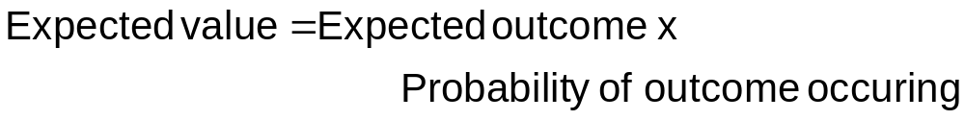
Expected Value
This analysis is used to include risk factors (probabilities) with payoff values for decision making
Basic premise:
Notes:
4

Slide 7
Expected Value Problem
Suppose you have to choose between one of three processes (A, B, or C) with the following monthly profit and respective probabilities of those profits being realized. Compute expected values and choose a process.
Process Payoffs Probabilities Pay x Prob. EV
A $6,000 90% 6,000x0.90 = $5,400
B $8,000 75% 8,000x0.75 = $6,000
C $9,000 65% 9,000x0.65 = $5,850
Select
Process
B
Notes:
4

Slide 8
Economic Life and Obsolescence
Economic life of a machine is the period time over which it provides the best method for performing its task
Obsolescence occurs when a machine is worn out
Notes:
4

Slide 9
Depreciation
Depreciation is a method for allocating costs of capital investment, including buildings, machinery, etc
Depreciation procedures may not reflect an asset’s true value because obsolescence may at any time cause a large difference between the true value and book value
Notes:
3

Slide 10
Depreciation Methods
Straight-Line Method
Sum-of-the-Years’-Digits (SYD) Method
Declining-Balance Method
Double-Declining-Balance Method
Depreciation-by-Use Method
Notes:
3

Slide 11
Traditional and Activity-Based Costing
Traditional Costing
Activity-Based Costing
Total overhead
Total overhead
Labor-hour
allocation
Pooled based
on activities
End product cost
Cost pools
Cost-driver
allocation
End product cost
Notes:
3

Slide 12
Choosing Among Investment Proposals:
Investment Decision Categories
Purchase of new equipment and/or facilities
Replacement of existing equipment or facilities
Make-or-buy decisions
Lease-or-buy decisions
Temporary shutdowns or plant-abandonment decisions
Addition or elimination of a product or product line
Notes:
4

Slide 13
Cost of Capital
The cost of capital is calculated from a weighted average of debt and equity security costs
Short-term debt
Long-term debt
Notes:
5

Slide 14
Interest Rate Effects
Compound value of a single amount
Compound value of an annuity
Present value of a future single payment
Present value of an annuity
Discounted cash flow
Notes:
5

Slide 15
Methods of Ranking Investments
Net present value
Payback period
Internal rate of return
Ranking investments with uneven lives
Notes:
6

Slide 16
End of Supplement B

